Slide 1
Project
Title of Project:
Analysis of Kansas and Chicago cities crimes on cloud computing
By
Shwel Alshehri

Slide 2
Analysis of Kansas and Chicago cities crimes on cloud computing
Progress
Design First Draft website for the project.
I used HTML and CSS programming Languages To design the website.
The website still needs to connect it with cloud computing service and direct users to the original sources for the data.

Slide 3
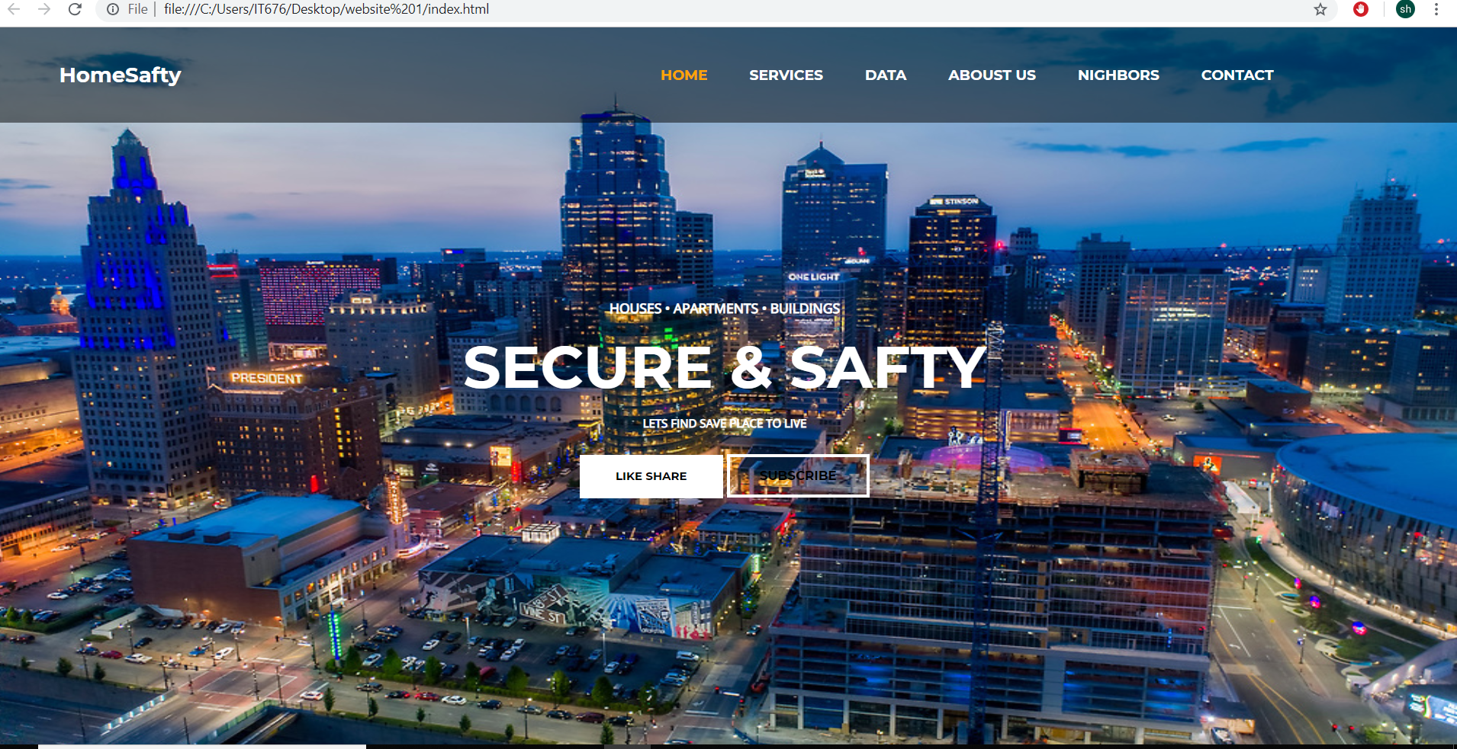
Analysis of Kansas and Chicago cities crimes on cloud computing
Here is the face for the website
Note: the website html and css
Fiels are within the email .

Slide 4
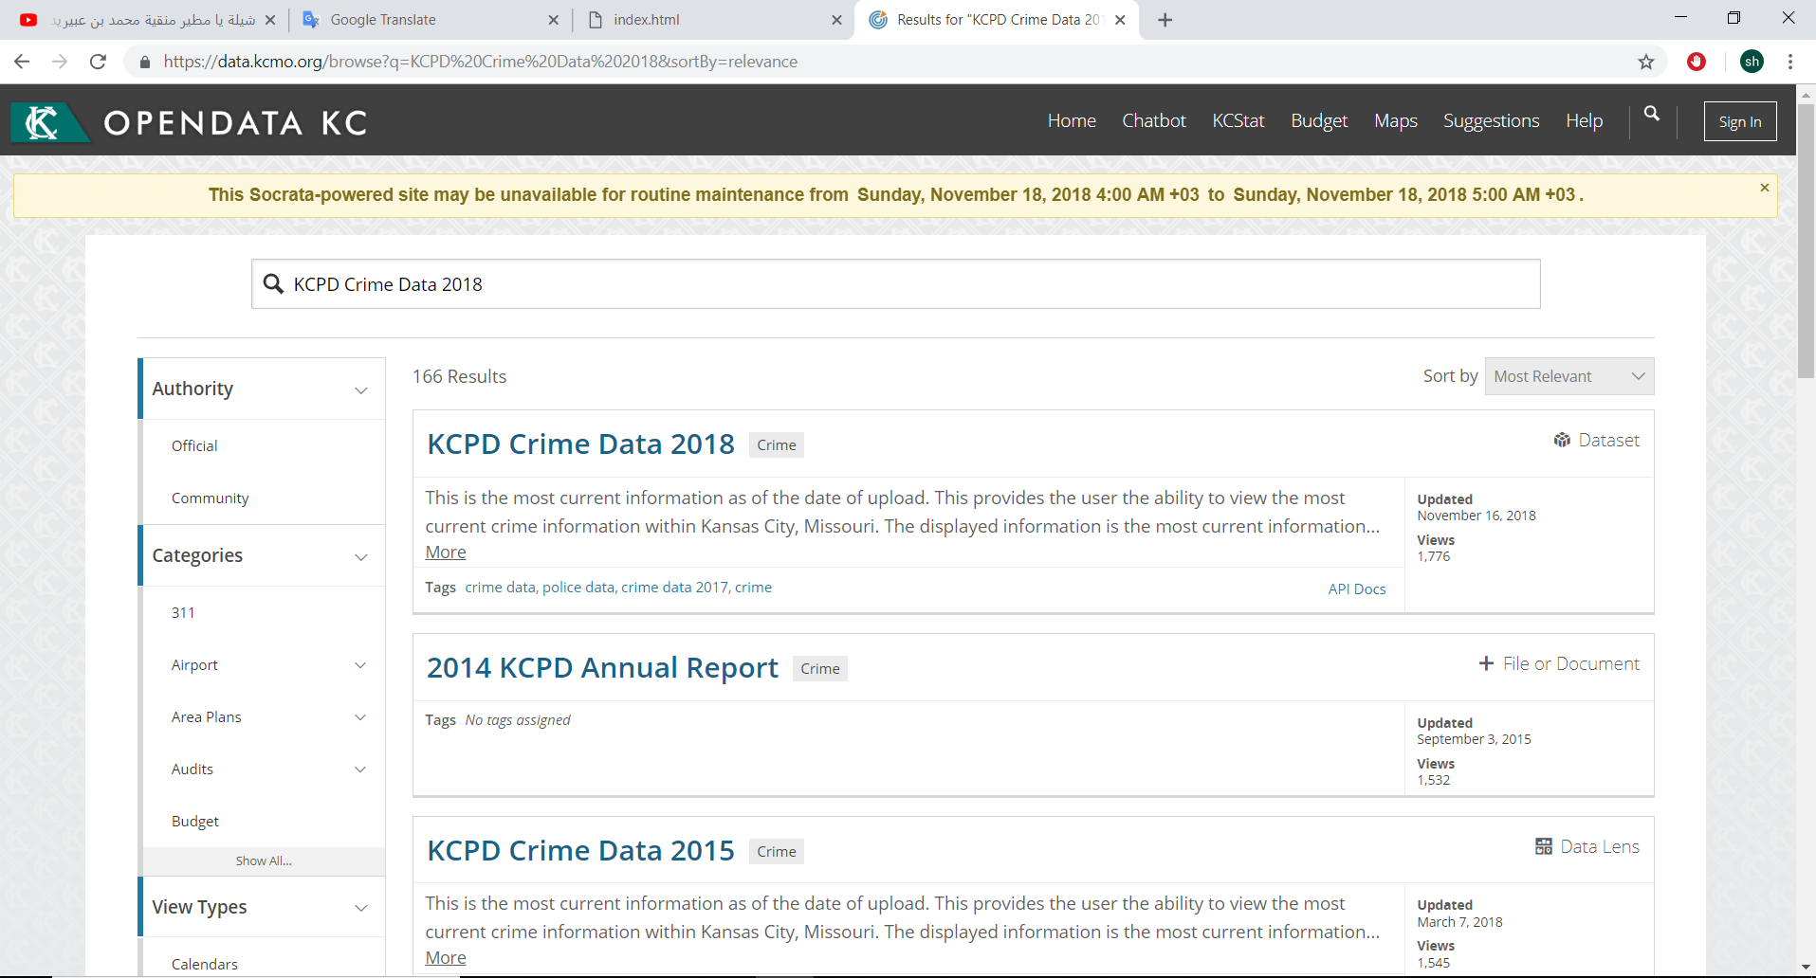
Analysis of Kansas and Chicago cities crimes on cloud computing
Collecting data and source
I take my data from the website
(https://data.kcmo.org).
Data are for crimes in Kansas
city for the years (2010-2019).

Slide 5
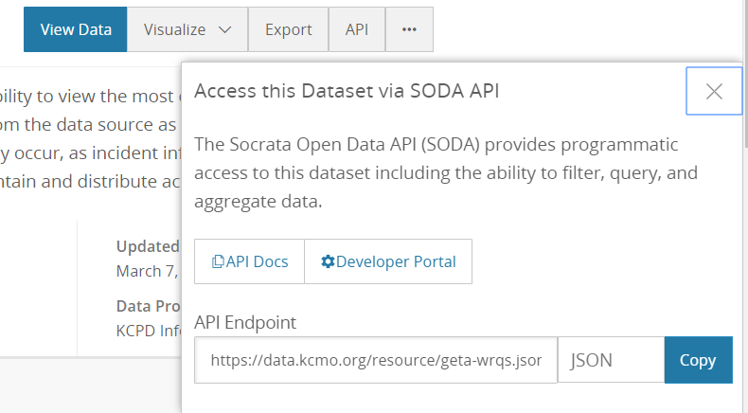
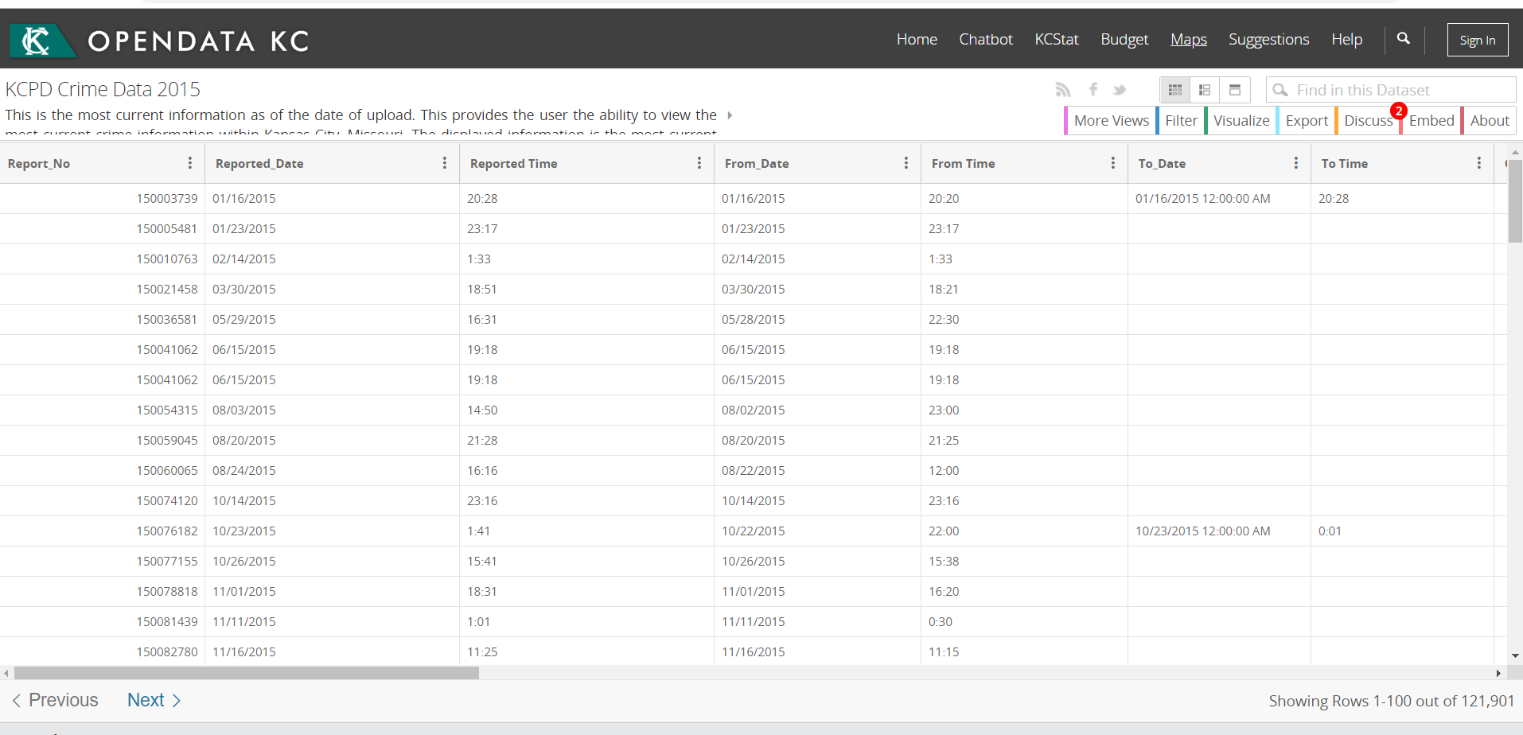
Analysis of Kansas and Chicago cities crimes on cloud computing

Slide 6
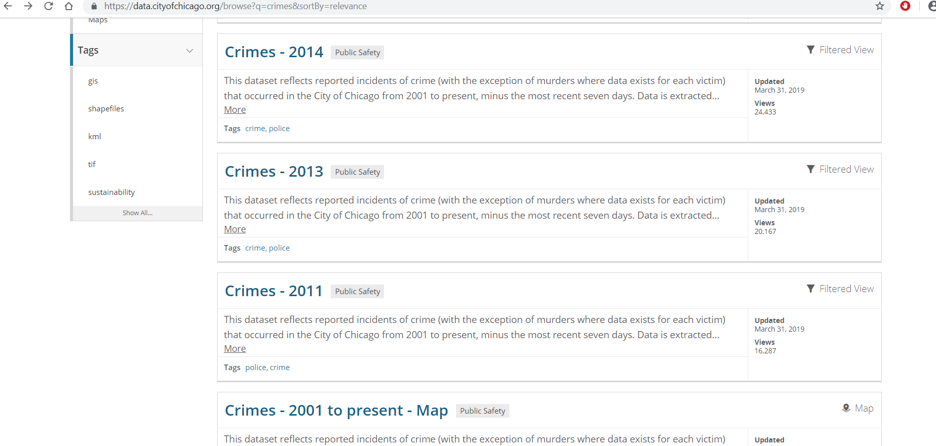
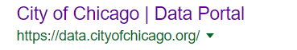
Analysis of Kansas and Chicago cities crimes on cloud computing
Collecting data and source
Chicago
Data source
Data from (2010-2019)

Slide 7
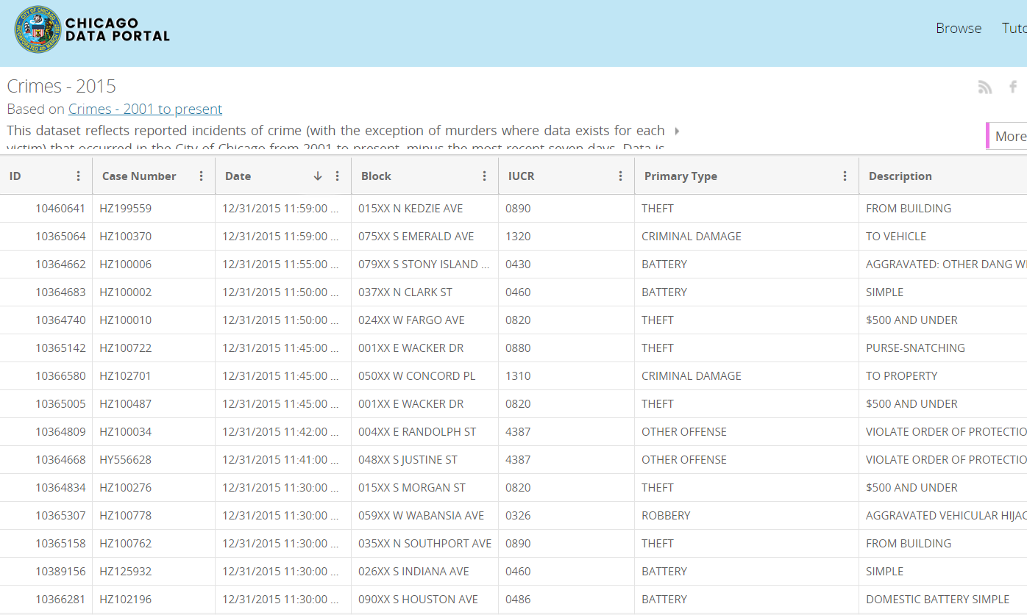
Analysis of Kansas and Chicago cities crimes on cloud computing

Slide 8
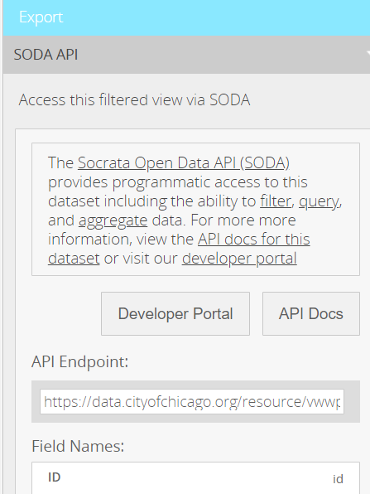
Analysis of Kansas and Chicago cities crimes on cloud computing

Slide 9
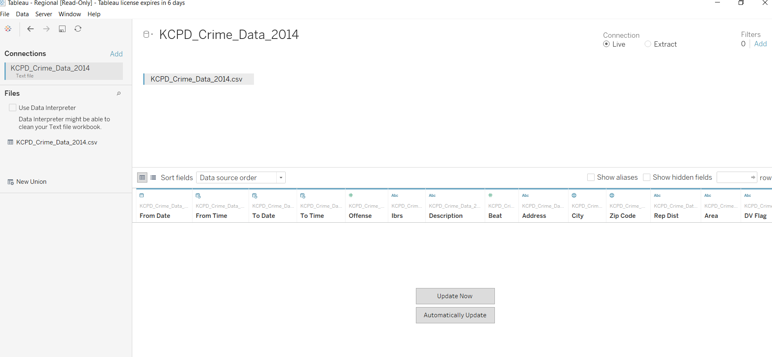
Analysis of Kansas and Chicago cities crimes on cloud computing
Data analyzing and visualization:
In this part ,I used a tool called
(Tableau).
As you see I used some file
Of my data to get analysis and
visualization.

Slide 10
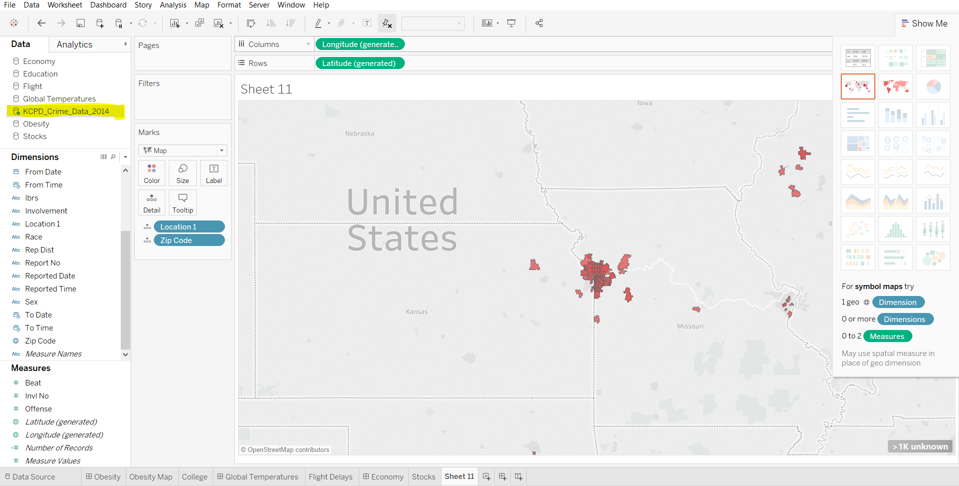
Analysis of Kansas and Chicago cities crimes on cloud computing
I still have problem how to
bring data from the source
directly.(just I take data as
csv file and add it to the
Tableau).
Here is an example for
Crime mapping on Kansas
City with zip code and
location>.

Slide 11
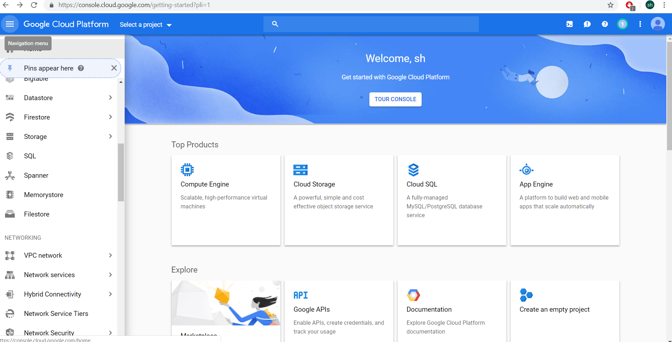
Analysis of Kansas and Chicago cities crimes on cloud computing
Cloud Computing Service
I will used Google Cloud
Platform for provide the
service in public

Slide 12
Thanks.

